Slide 1

Promises

Slide 2
Promises history
Implemented before ES 2015
koncept z 1976
jQuery Deferred 2011
dojo toolkit 2012
$q ????
bluebird 2013
...
„standardized“ before ES 2015
http://wiki.commonjs.org/wiki/Promises
CommonJS:
Promises/A by Kris Zyp — "Thenables"
Promises/B by Kris Kowal — Opaque Q API
Promises/KISS by AJ ONeal
Promises/C has been redacted
Promises/D by Kris Kowal — "Promise-sendables", for interoperable instances of Promises/B.

Slide 3
Promises - motivation
RECAP - callbacks, in fact, are not specialized async API, callbacks can be used to express async APIs (continuation) because JS has functions as first class object
Motivation: create Async API for JS - promises try to solve the “problems“ of callbacks
lack of sequentiality
lack of trustability
manage basic concurrency patterns

Slide 4
Promises - features
A Promise is an object representing the eventual completion or failure of an asynchronous operation
Instead of „returning from async function“ by calling callback, we return Promise object, instead of immediately returning the final value, the asynchronous method returns a promise to supply the value at some point in the future.
Promise is a returned object to which you attach callbacks, instead of passing callbacks into a function
Instead of handing the continuation of our program to another party, we have now capability to know when its task finishes, and then our code could decide what to do next

Slide 5
Promises - features
Callbacks will never be called before the completion of the current run of the JavaScript event loop or in other words: functions passed to then() will never be called synchronously
Callbacks added with then() even after the success or failure of the asynchronous operation, will be called.
Multiple callbacks may be added by calling then() several times. Each callback is executed one after another, in the order in which they were inserted
Promises are chainable
Promises support Error propagation
Support basic async patterns – waterfall, all, race
...

Slide 6
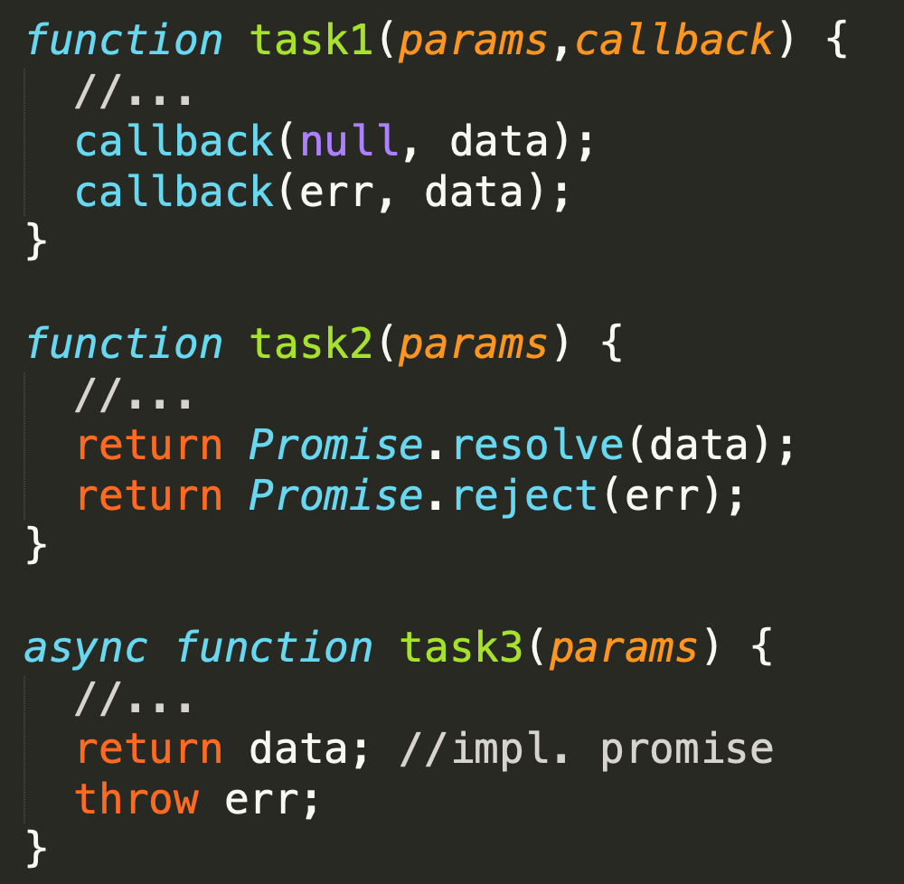


Async function - definitions
RECAP
now
later
V8 stack
Pod async funkciou budeme zjednodušenie rozumieť jednu z konštrukcií, ktorá nám umožní zapísať, že niečo sa deje NOW a potom LATER. V zásade existujú 3 možnosti ako je async funkcia implementovaná:
funkcia, ktorá v signatúre očakáva callback
funkcia, ktorá vracia Promise
ES2017 AsyncFunction

Slide 7
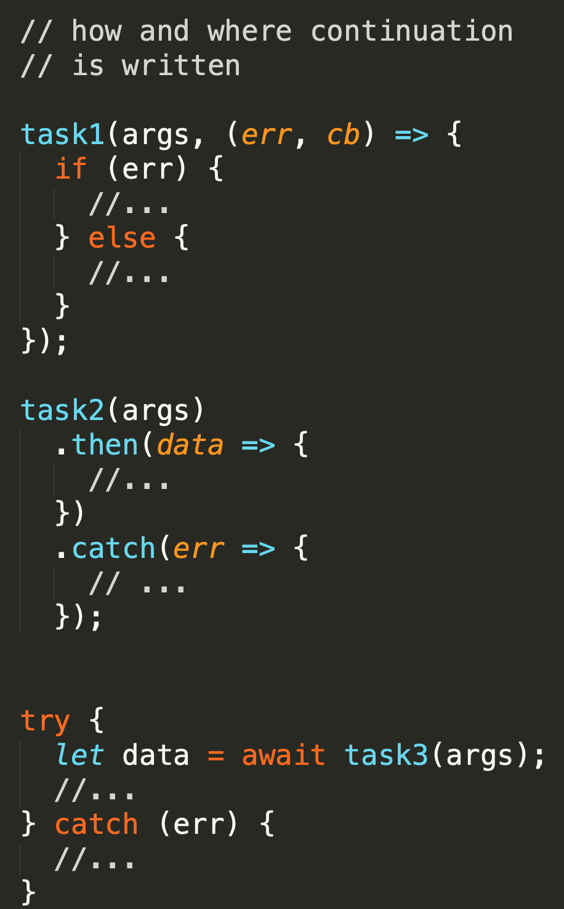


Async function - usage
RECAP
1995-2020
now
later
V8 stack
Podľa toho potom rôzne zapisujeme „later“
funkcia, ktorá v signatúre očakáva callback
funkcia, ktorá vracia Promise
ES2017 AsyncFunction
Niektoré knižnice sú napísané štýlom A) iné B) iné podporujú A/B/C ..... Niektoré runtimes podporujú len A, niektoré A,B,C
2010
2015-2020
2017-2020

Slide 8
Working with promises
How do we get promise:
using API that already returns promises (most of newer APIs already do)
Converting cb-async-function to promise-async-function
Using promisified npm module
Manually creating new Promise
new Promise()
Promise.resolve()
Promise.reject()
Result of „combining“ promise async functions (.then) and promises (.all, .race)

Slide 9
Working with promises – promise API
How do we use promises:
then()
catch()
finally()
promise.all()
promise.race()
Non standard
.done()
.cancel()
Promise.any()
...

Slide 10
node.js APIs - How do we get promise ?
node core modules already producing promises (10+, experimental APIs)
DNS Promises API
FS promises API
...
converting callback APIs to promises
util.promisify
...
Promisified modules (on npm)
request-promise
fs-extras
...
Hybrid modules: (returns a Promise if no callback is passed to it)
node-mongodb-native
...

Slide 11
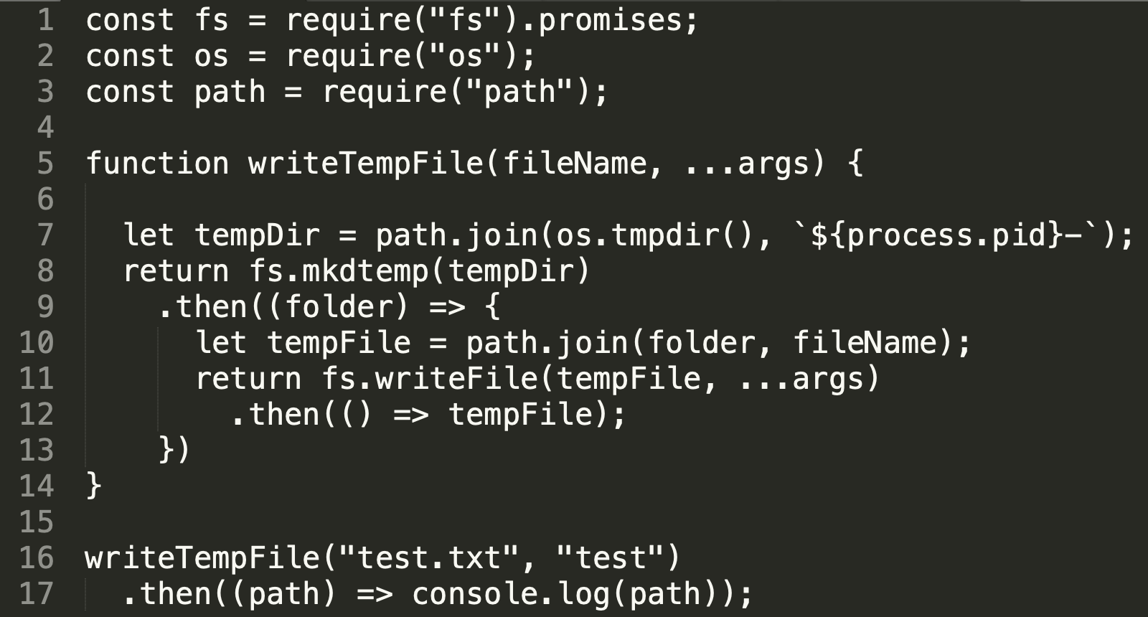
fs.promises example
[1] – require promisified version of fs module
[8] – mktempdir now returns promise, when folder is created then [9] call another function, which creates file [11], which once created, return name of the tempFile [12].
07-prednaska/samples/03-promises/01-fs.promises
See compared with cb style on next slide

Slide 12
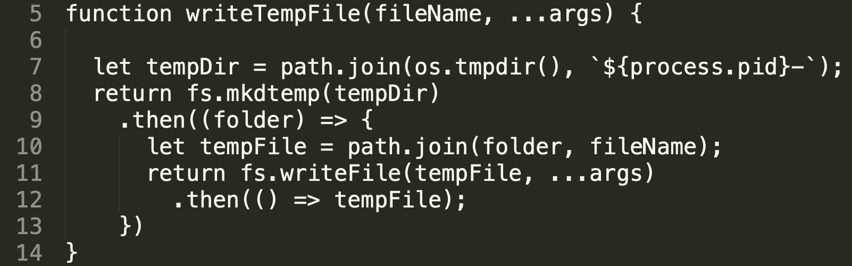
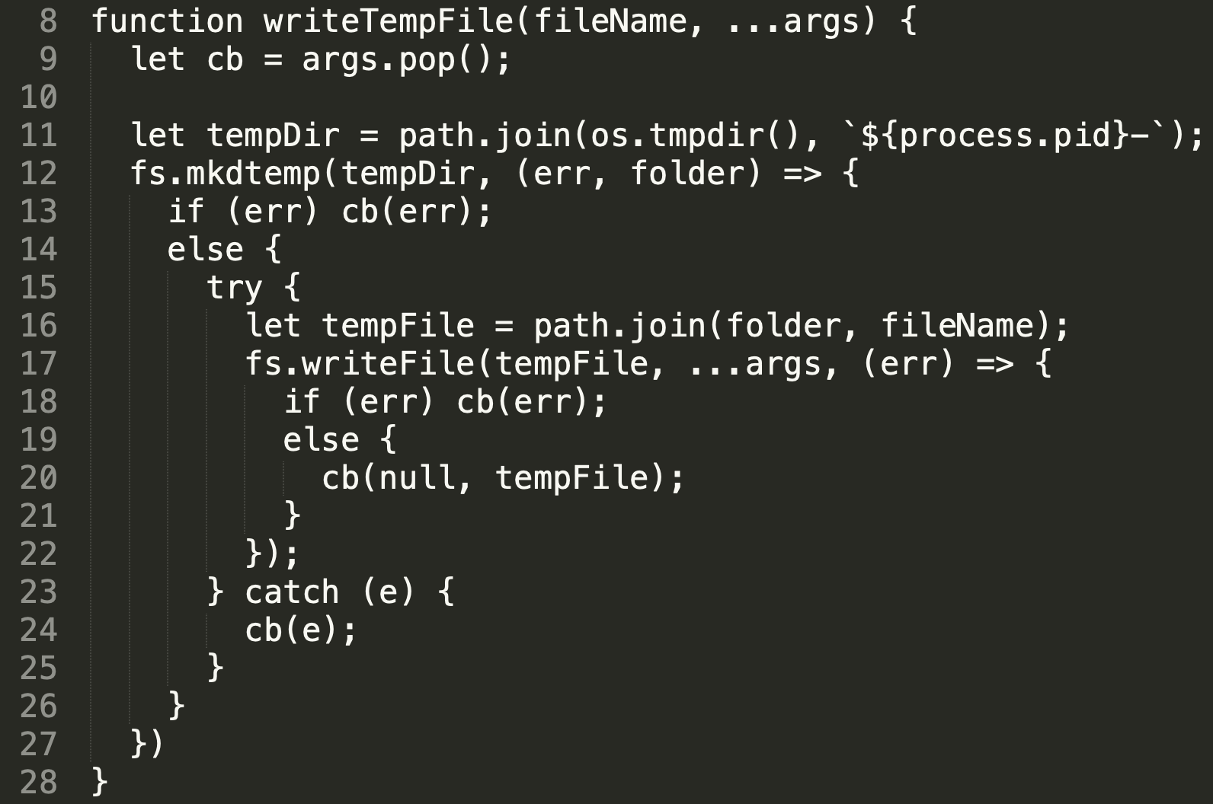
Promises vs. callbacks, writeTempFile samples
clean signatures, no cb
return statement instead of CB
error propagation
sync error handled inside then() as well
less cluttered
07-prednaska/samples/03-promises/01-fs.promises

Slide 13
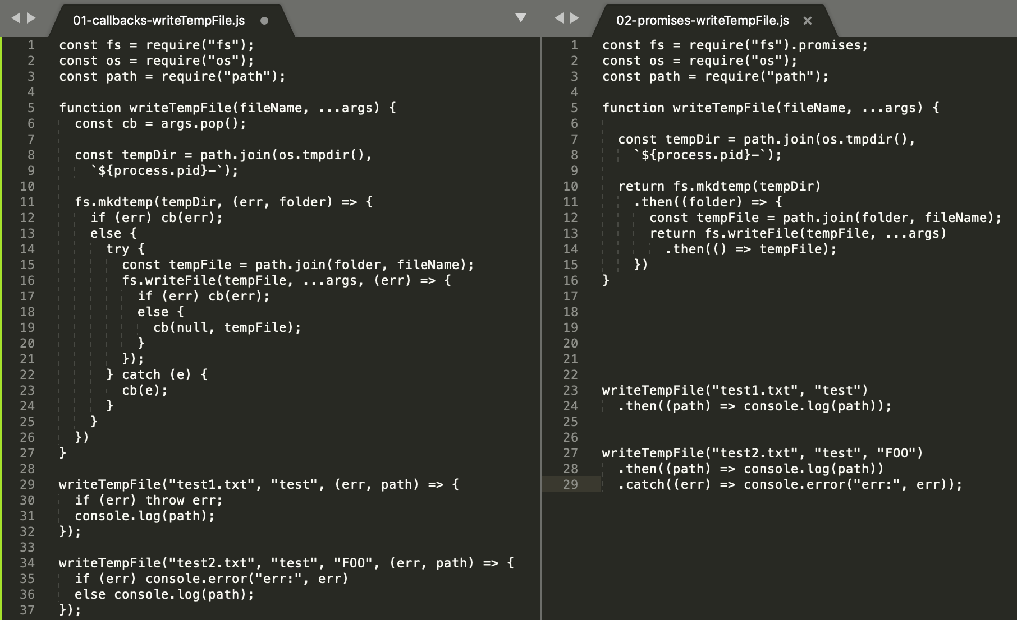

Slide 14
Promises
RECAP
Remember:
promises have nicer syntax and more “linear code”
but this is not (only) about syntax
its about promises features eliminating “real callback hell problems”
called once
called async
async and also sync errors propagation
…..

Slide 15
Promises API

Slide 16
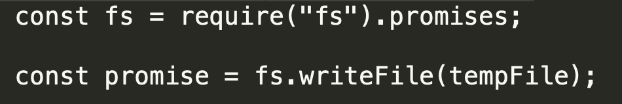
Promises states
pending
settled
fulfilled
rejected
Pending – operácia prebieha
Fulfilled – operácia zbehla úspešne
Rehected – operácia zlyhala

Slide 17
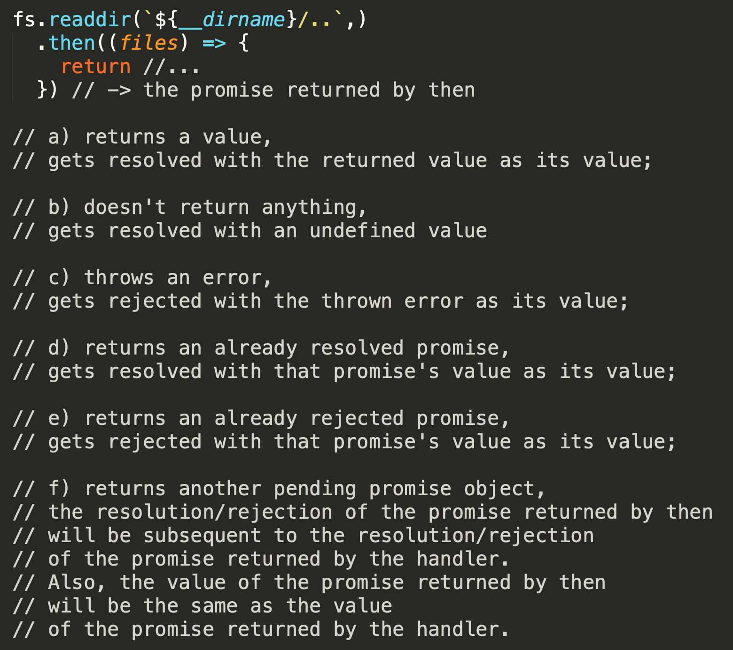
promise.then(onFulfilled); - return values
A function called if the Promise is fulfilled.
This function has one argument, the fulfillment value
returns a Promise in the pending status
gets called asynchronously, (when the stack is empty)
onFulfilled môže byť sync aj async funkcia
sync can return
value
does not return
throws
async can return Promise
pending
fulfilled
rejected
Notes:
funkcia v then() (onFulfilled) moze vratit niekolko moznych hodnot,
tu je rozpisane co sa stane a aku promise vrati then, ked funkcia onFulfilled
dopadne jednym z popisanych sposobov.

Slide 18
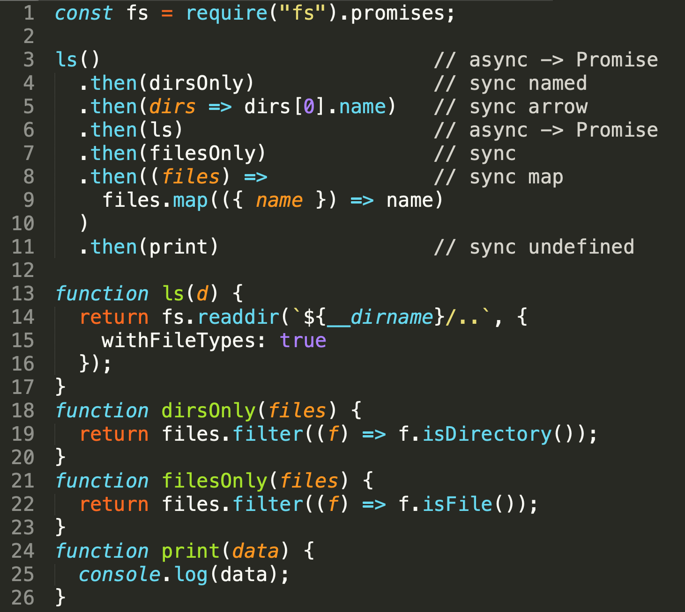
promise.then(onFulfilled); - chaining
returns a Promise in the pending status
so it can be chained
you can have chain of sync and async functions mixed
as arrows or as named functions
07-prednaska/samples/03-promises/02-promises-api/02-then-chaining.js
Notes:
Z predosleho slajdu by malo byt jasne ze ked funkcia v then() vrati value (ako normalna sync funkcia)
then ju zabali do promise....
toto nam umoznuje kombinovat v ramci then() chainu, sync aj async funkcie.
ci nieco napiseme ako arrow alebo extrahneme do samostatnej funkcie zalezi
na nasom coding style, moznosti reusu danych funkcii atd... tuna je to pomisenane kvoli demu
aby ste si uvedomili ako vselijako sa to da zapisat.
Pozor neskorej si este ukazeme ako „nekombinovat“ sync aj async

Slide 19
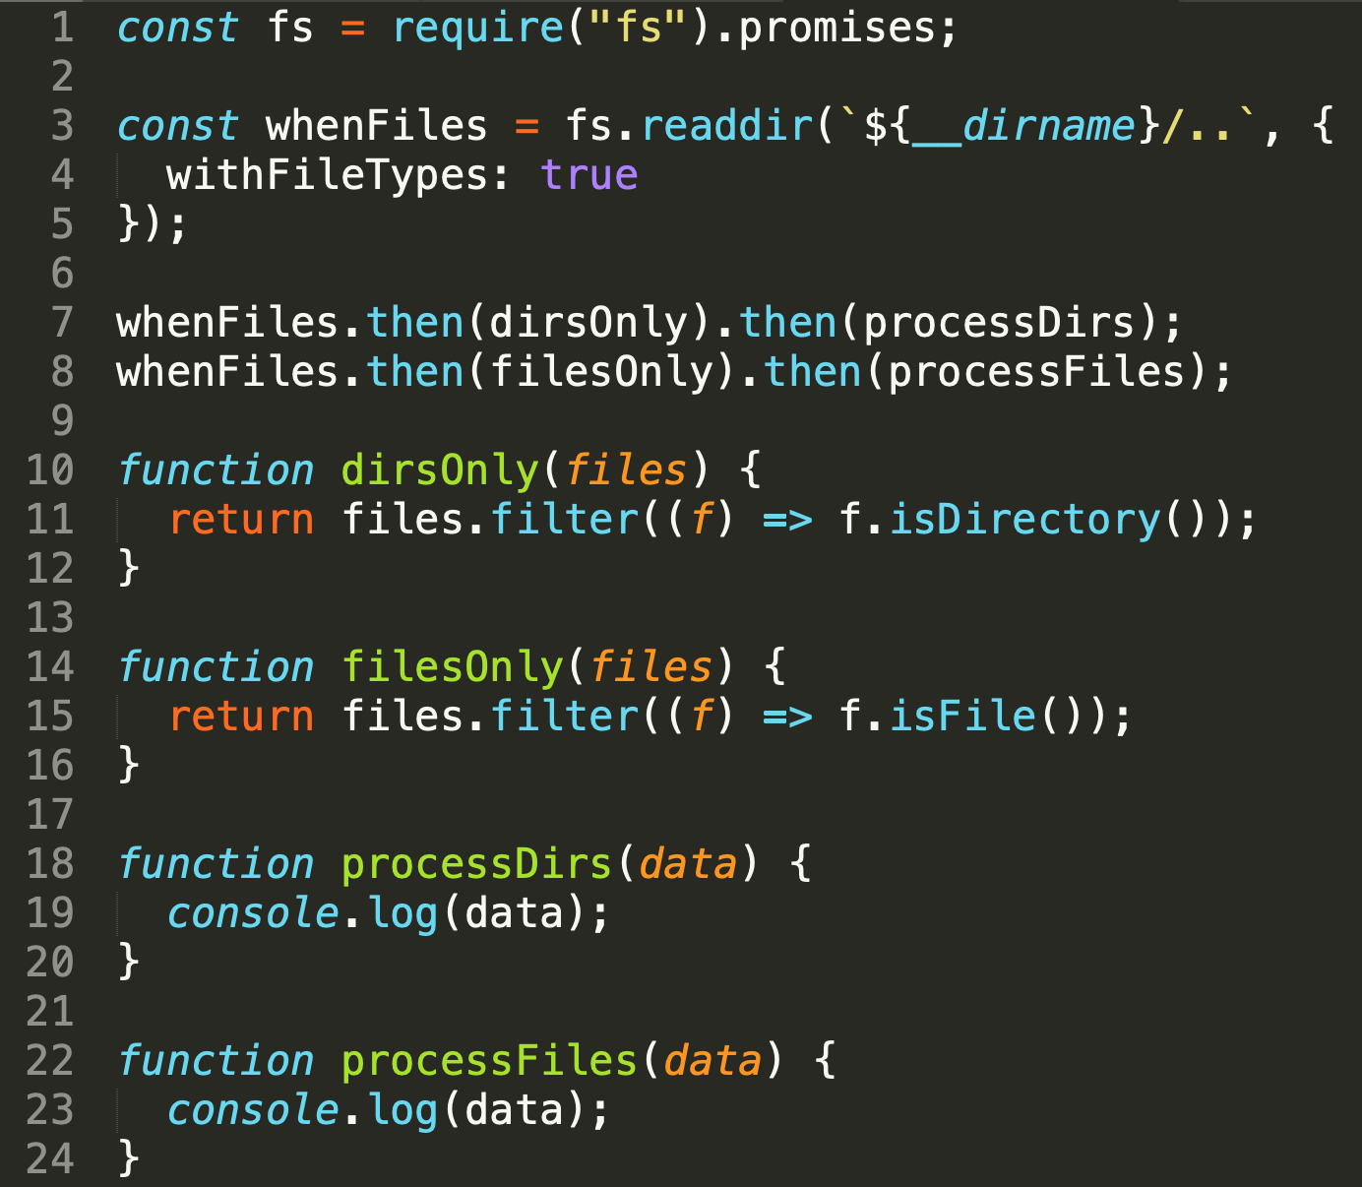
promise.then(onFulfilled); - multiple
not chaining syntax, naming promises
Multiple callbacks may be added by calling then() several times.
Each callback is executed one after another, in the order in which they were inserted
can have more declarative code
instead of when.then.then (procedural), we can have
when, then, when, then style – remember async.js and auto sample
07-prednaska/samples/03-promises/02-promises-api/03-then-multiple.js

Slide 20
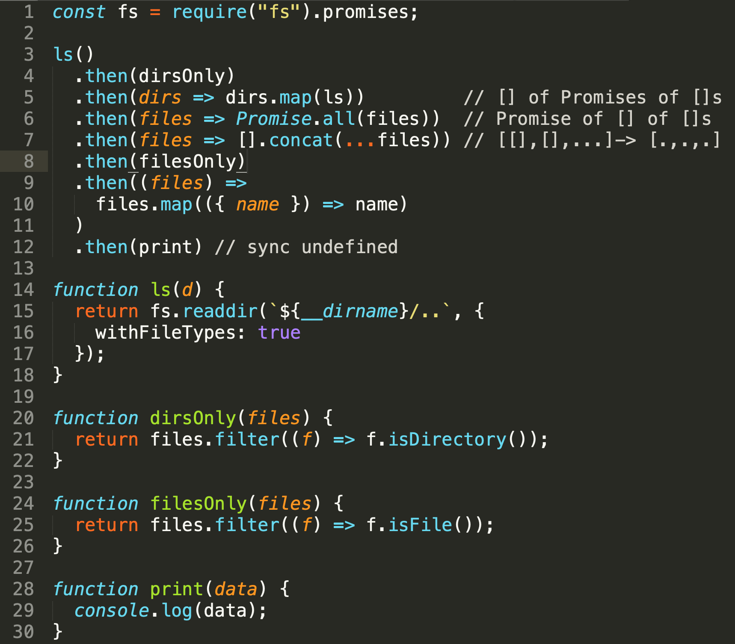
array of promises Promise.all
[].map(async) -> [] of Promises
ls is async function
how to wait for all promises to be resolved: Promise.all
Then we have [] of values
The Promise.all(iterable) method returns a single Promise that resolves when all of the promises in the iterable argument have resolved or when the iterable argument contains no promises. It rejects with the reason of the first promise that rejects.
07-prednaska/samples/03-promises/02-promises-api/04-array-of-promises.js

Slide 21
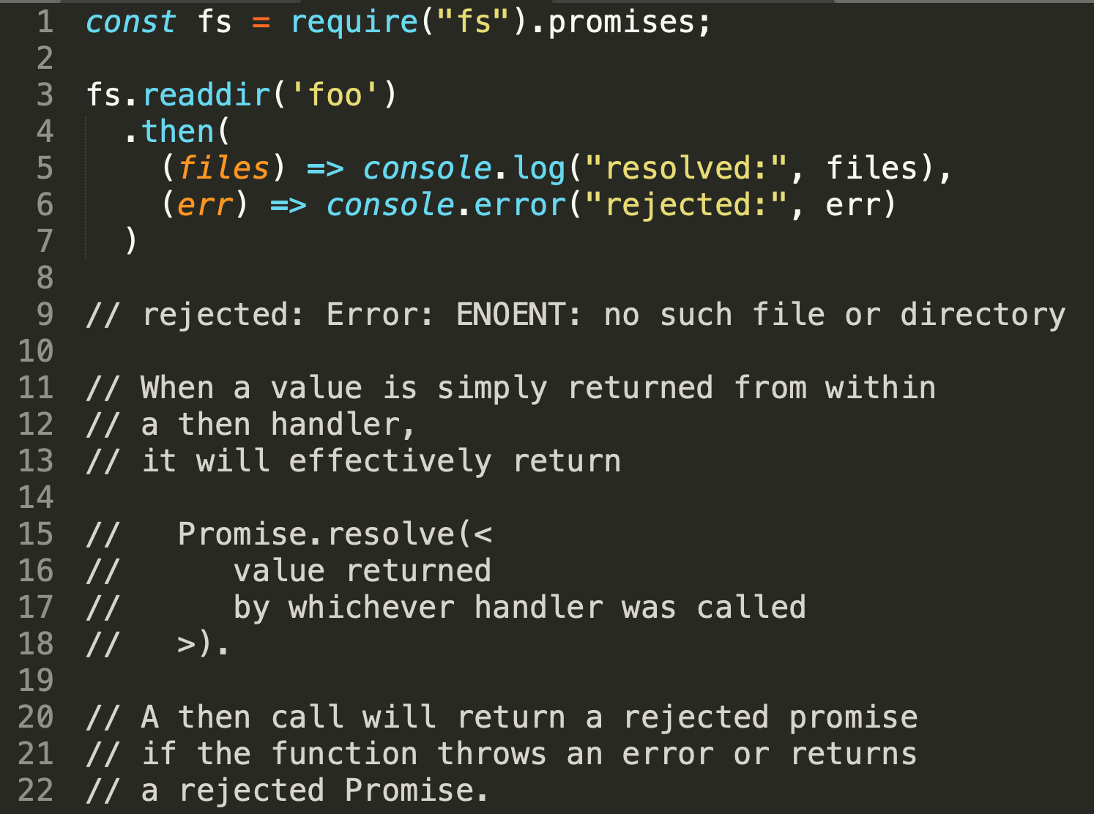
promise.then(onFulfilled, onRejected);
onRejected – 2nd parameter of then
a function called if the Promise is rejected. This function has one argument, the rejection reason.
If it is not a function, it is internally replaced with a “thrower" function (it throws an error it received as argument).
Notes:
Pouzivanie orRejected sa dneska povazuje za antipattern
lebo mame promise catch()
tak sa aspon pozrime na zaklad,
aby ste to vedeli aspon citat.....

Slide 22
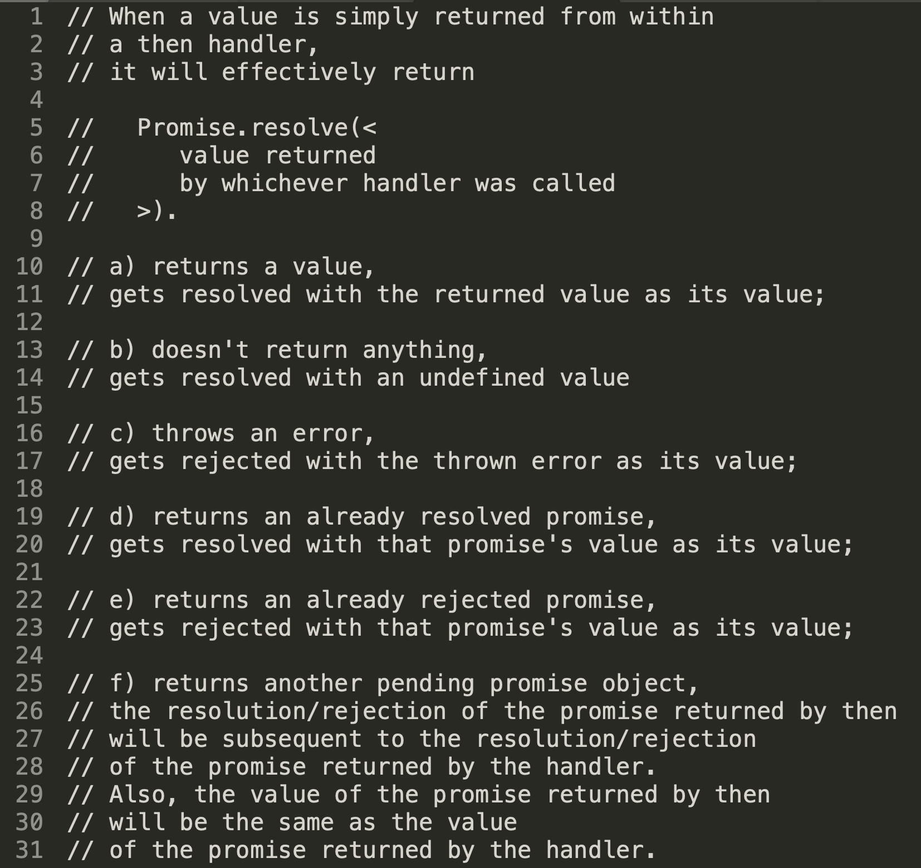
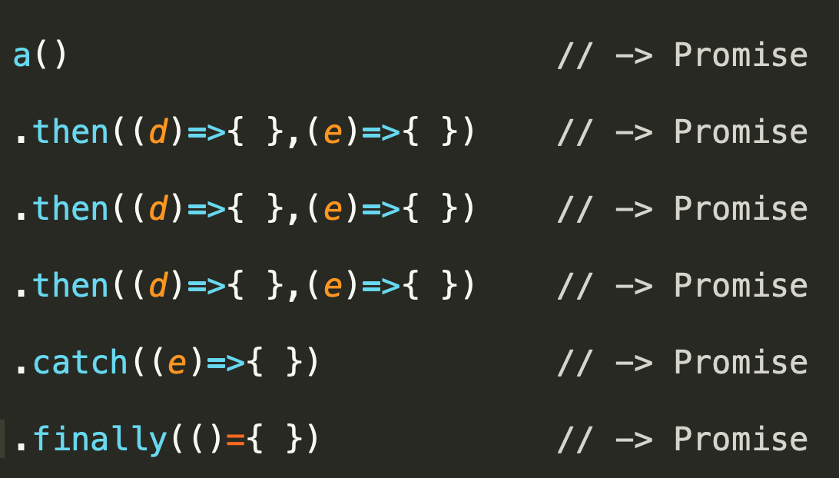


promise.then(onFulfilled, onRejected);
on fulfilled on rejected, same rules for return values apply for both
We need to understand this to understand chaining and error handling

Slide 23

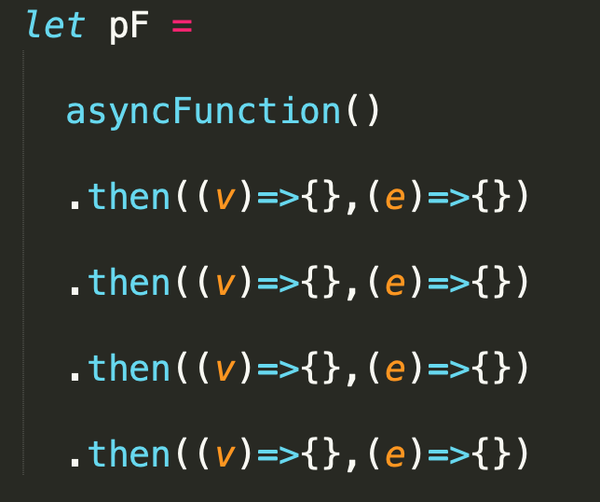
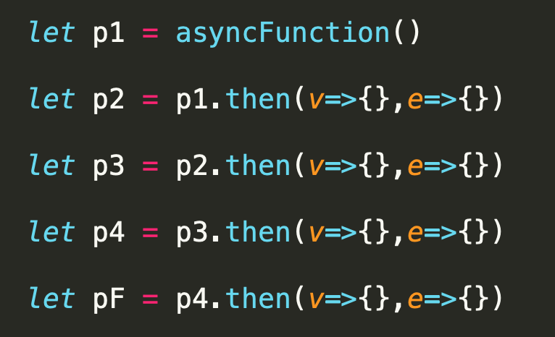
then() returns a Promise
A) Zápis ako chain
B) Zápis ako sekvencia
Pending
Pending
Pending
Pending
Pending
Notes:
Treba si uvedomit ze ten chain zapis je to iste ako ten sekvencny zapis,
znamena to ze pF (finalny promis) bude resolvnuty az ked budu resolvnute vsetky predtym.
pF je vysledkom resolvingu posledneho promisu, ten sa resolvne podla predosledho atd....
Co sa tyka poradia vykonavania,
pusti sa asyncFunction
vytvori sa 5 pending promises
dobehne async function
resolvne sa prva, pustia sa handlery p1.then(), bud on fulFillled alebo onRejected, podla vysledku asyncFunction
ked dobehnu (mozu byt async alebo sync) a podla toho ako dobehli resolvne sa P2
to iste potom pre P3, P4
ked dobehne P4, podla toho ako dopadnu jej handlery resolvne sa PF na finalnu hodnotu
treba si uvedomit ze then().then().then() je synchronny kod takze nam tym zapisom ozaj
vzniklo 5 promisov,
prvy realny z async operacie, 4 dalsie z then a vysledok je hodnota toho posledneho resolvnuta podla handlerov p4.then()
je jedno aky handler sa zavola nad then() dolezite je ako dopadne / co vrati

Slide 24
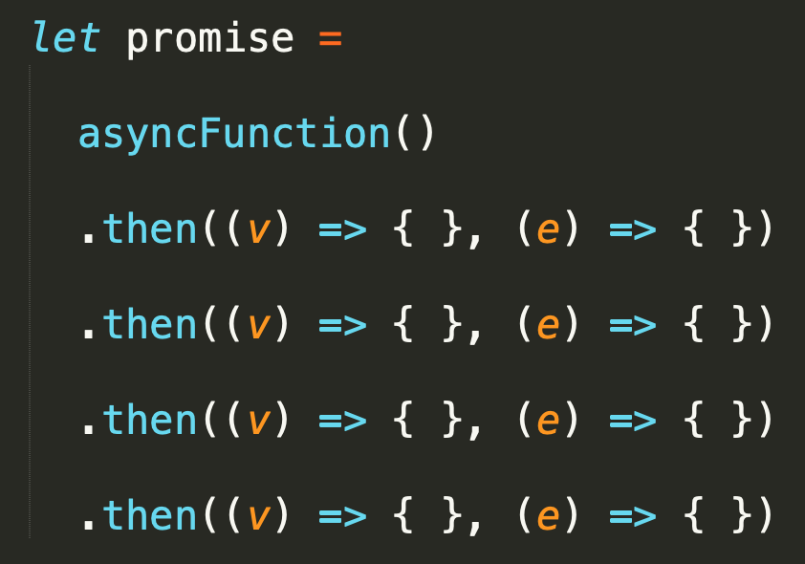
Chaining scenarios
Vznikne nam 5 pending promisov, vsetky su pending
dobehne async, prva promise je fulfilled alebo rejected
zavolaju sa prislusne then handlery a podla toho sa resolvne p2, podla toho ako sa resolvla p2 sa zase zavolaju prislusne handlery a resolvne sa p3, atd... az po finalny resolve pF
fulfilled
rejected
Pending
fulfilled
rejected
Pending
fulfilled
rejected
Pending
fulfilled
rejected
Pending
fulfilled
rejected
Pending
fulfilled
rejected

Slide 25
Chaining scenarios
Appropriate handler is called, once the promise is settled (fullifiled or rejected). Based on the result value of handler, next handler is called etc...
fulfilled
If the handler throws or returns rejected promise, onRejected handler is called,
If the handler returns value or nothing, or fulfilled promise, the onFulfilled handler is called
x
Pending
fulfilled
x
Pending
rejected
r
Pending
fulfilled
r
r
Pending
fulfilled
r
Pending
fulfilled
Notes:
async dobehne fajn, p1 je fulfilled
pusti sa onFulfilled handler
ten robi nejaku operaciu a popada (throws, alebo vrati rejected promise) , p2 je rejected
pusti sa onRejected handler nad tym p2 promisom a ten nepopada, ale vrati nejaku value (osetri vynimku), p3 je teda fulfiled
pusti sa teda nad p3 jej onfulfilled handler, ten vrati value/resolved promise, p4 je resolved
a pusti sa teda nad nim onfilfilled a ten dopadne ok a teda p5 (pF, promise) je resolved

Slide 26
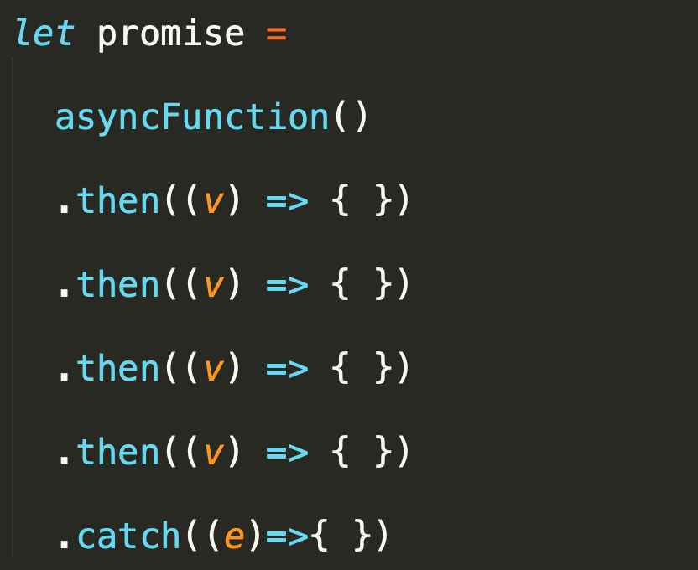
then and catch
then(onRejected) - If not a function, it is replaced with a "Thrower" function (it throws an error it received as argument).
The catch() method returns a Promise and deals with rejected cases only. It behaves the same as calling Promise.prototype.then(undefined, onRejected)
Pending
fulfilled
Pending
rejected
Pending
rejected
Pending
rejected
Pending
rejected
Pending
fulfilled
rejected

Slide 27
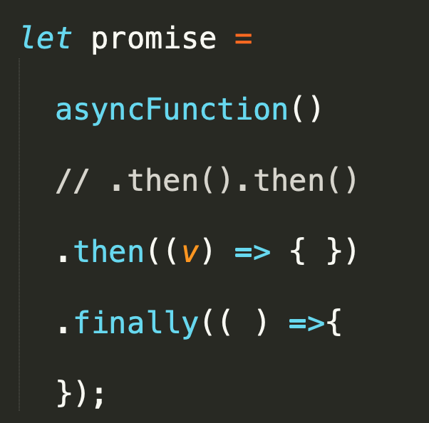
then, and, finally
Handling settled promise (rejected or fulfilled)
It receives no argument
It returns Promise, which is resolved or rejected „based on previous promise“
unless finally throws, then the promise is rejected with thrown error
return from finally is ignored
fulfilled
rejected
Pending
fulfilled
rejected
r
x
Pending
fulfilled
rejected

Slide 28
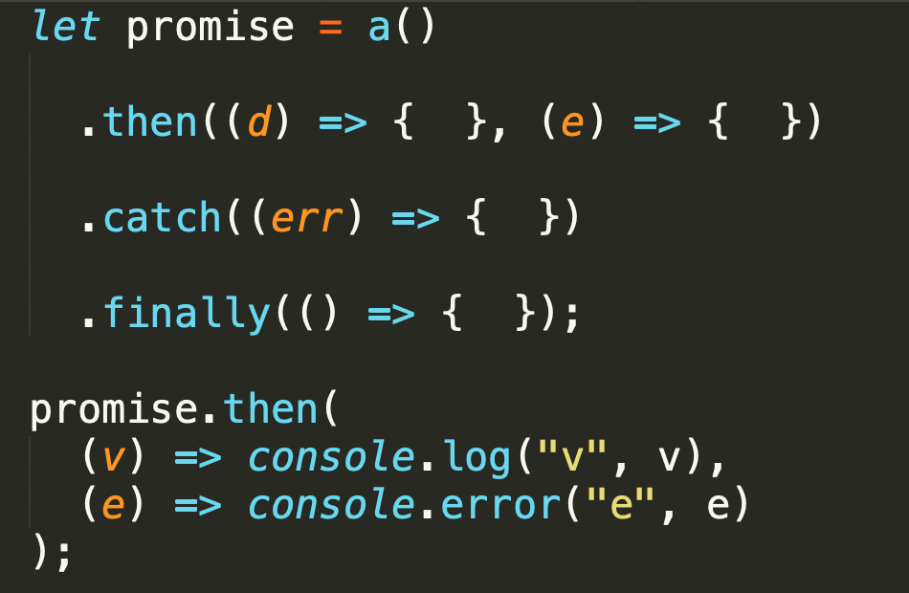
Then, catch, finally
r
x
Mali by ste rutinne dokázať riešiť takéto matice situácií: čo ak popadá a(), čo ak onFulfilled vráti rejected promise, ak onRejected vráti undefined, ak catch nerethrowne exception atď....
r
x
r
x
r
x
r
x
?

Slide 29
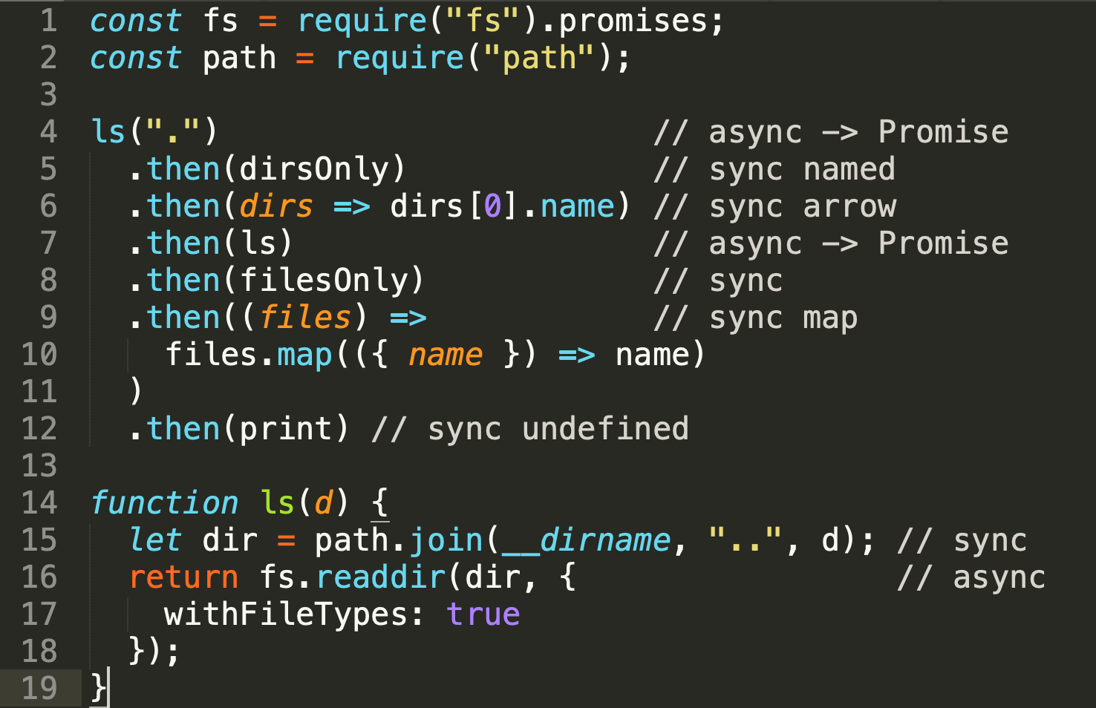
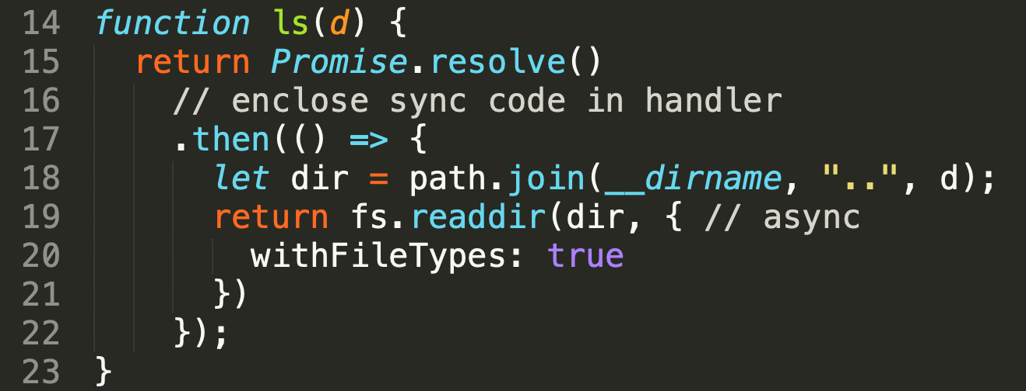
Mixing sync and async code
One of the solutions:
Enclose the sync code in callback internally as well
To do this, enclose mix [18,19,20] in handler [17]
To be able to do .then() you need a promise, created by Promise.resolve [15] with undefined value
x
x
x
Async function contains mix of sync and async code, problem:
What if line 15 (sync) fails ?
For line 7 when ls is callback this is ok and will be wrapped as Rejected promise
For line 4 it is a problem and program fill fail with unexpected exception and not with rejected promise
See other options:
http://2ality.com/2016/03/promise-rejections-vs-exceptions.html

Slide 30
Mixing sync and async code
keď kódujete async funkcie, nemali by ste miešať sync a async kód, najmä ak sync kód môže hodiť sync exception. Takáto funkcia je problém, ak nie je použitá v rámci then.
Buď budete kódovať vašu funkciu ako:
Promise.resolve().then({sync/async mix})
alebo try{sync} catch{ Promise.reject(ex)}, async
....
... alebo budete každý flow začínať Promise.resolve().then().then().... aby sa problémová funkcia vyskytla „obalená“ v then

Slide 31
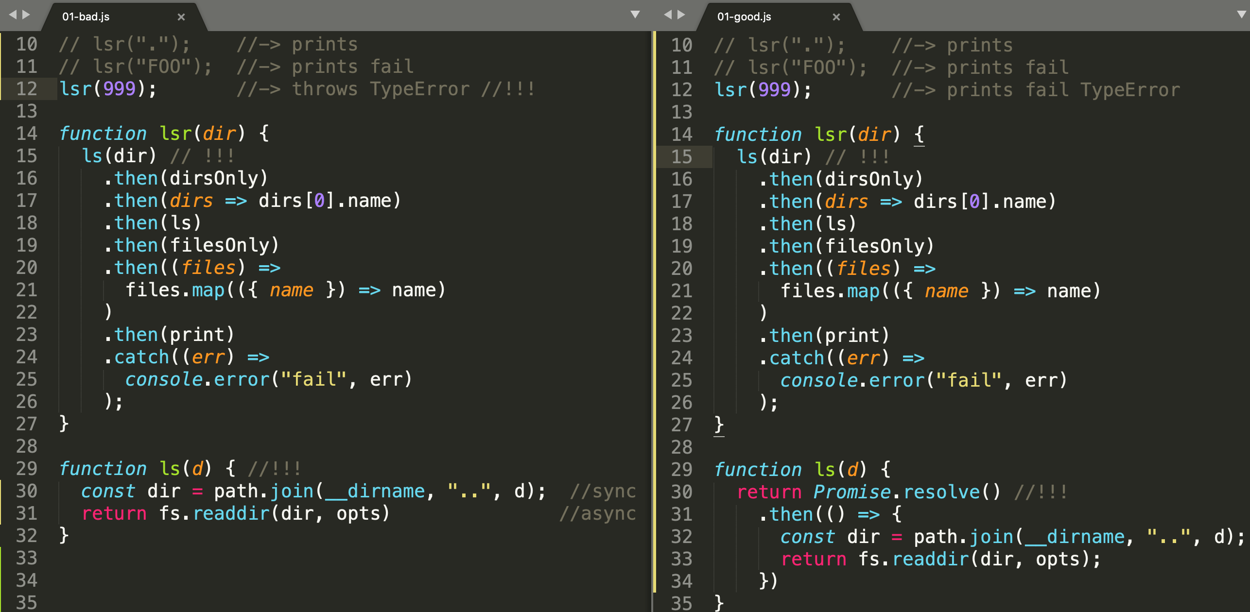
Mixing sync and async code

Slide 32
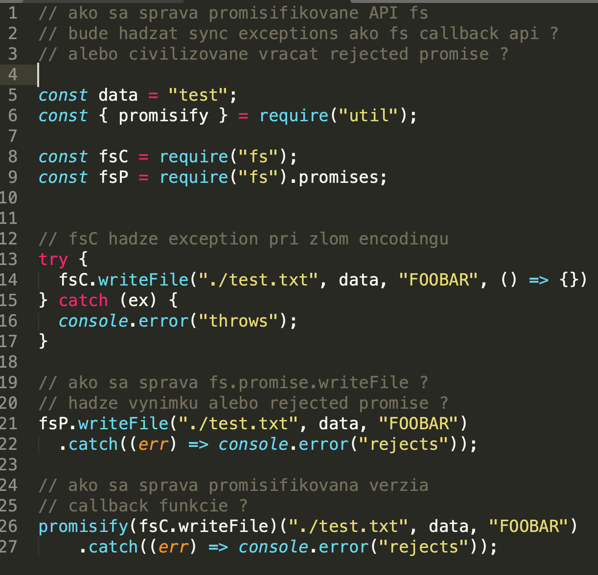
Mixing sync and async code –alebo sync výnimky z async kódu
Otázka znie kedy je sync výnimka by design (???) a kedy nie, alebo prečo niekto kódol writeFile tak, že hádže sync výnimku, keď je zlý encoding a async error keď file neexistuje ? Čo je ozaj výnimka (async error) a čo je bug (zlý encoding)
07-prednaska/samples/03-promises/04-mixing-sync-async/02-writeFile.js
Notes:
CB verzia sa sprava “nekonzistentne“ raz hadze sync vynimku, inokedy callback error.
Primisified verzie sa uz spravaju podla predosleho BEST PRACTICE a v oboch pripadoch koncia
ako rejected promise....

Slide 33
Patterns with promises

Slide 34
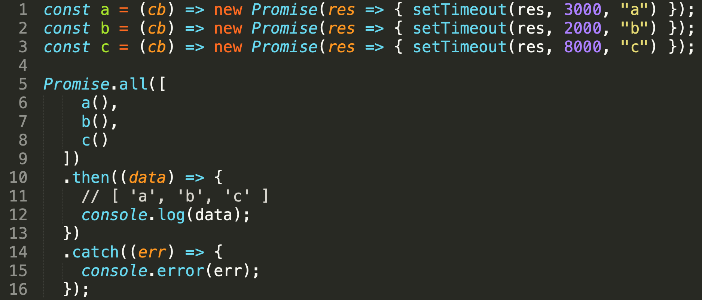
Promise.all
The Promise.all (iterable) method returns a single Promise
That resolves when all of the promises in the iterable argument have resolved or when the iterable argument contains no promises.
It rejects with the reason of the first promise that rejects.

Slide 35
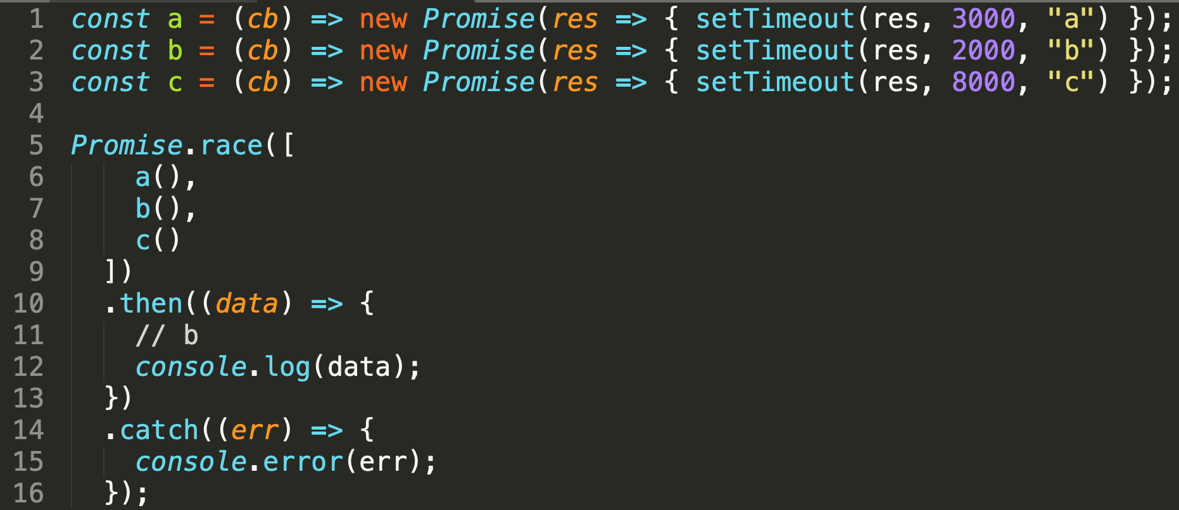
Promise.race
The Promise.race(iterable) method returns a promise
that resolves or rejects as soon as one of the promises in the iterable resolves or rejects, with the value or reason from that promise.

Slide 36
waterfall
syntakticky zapis pomocoy then.then.then je vlastne waterfall
ale co ked je zoznam taskov dynamicky ? v nejakej premennej ?

Slide 37
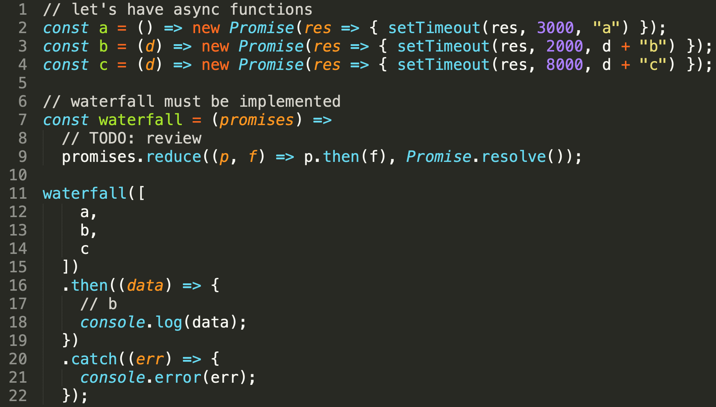
waterfall
This pattern is not part of the promises API, it can be implemented by chaining with reduce() or by other techniques

Slide 38
Other patterns and custom libraries
async.js + asyncify
bluebird.js - Promises in Node.js 10 are significantly faster than before. Bluebird still includes a lot of features like
cancellation, iteration methods and warnings that native promises don‘t.
If you are using Bluebird for performance rather than for those - please consider giving native promises a shot and running the benchmarks yourself.
https://github.com/petkaantonov/bluebird/issues/1434
....
....
ES2017 async Functions, await and generators

Slide 39
Prínos a výhody promise API
RECAP
Na prvý pohľad:
Krajšia syntax a lineárny kód
Error handling kód “separovaný mimo” a nie pomiešaný v kóde
Podstatné:
funkcia v then() bude zavolaná vždy asynchrónne
nebude v then() nebude nikdy zavolaná viackrát
môžeme mať niekoľko then() nad jedným now, s garantovaným poradím vykonania
ľahšie kombinovanie async a sync funkcií

Slide 40
Anti patterns
http://bluebirdjs.com/docs/anti-patterns.html
http://2ality.com/2016/03/promise-rejections-vs-exceptions.html
...

Slide 41
ES2017 Async Functions
Simplified introduction to new ES 2017 syntax

Slide 42
RECAP: async-function definition
“async-function“: Minule sme si zadefinovali async funkciu pre naše potreby takto:
run-to-completion - a zadefinovali funkciu ako zaklad atomicity

Slide 43
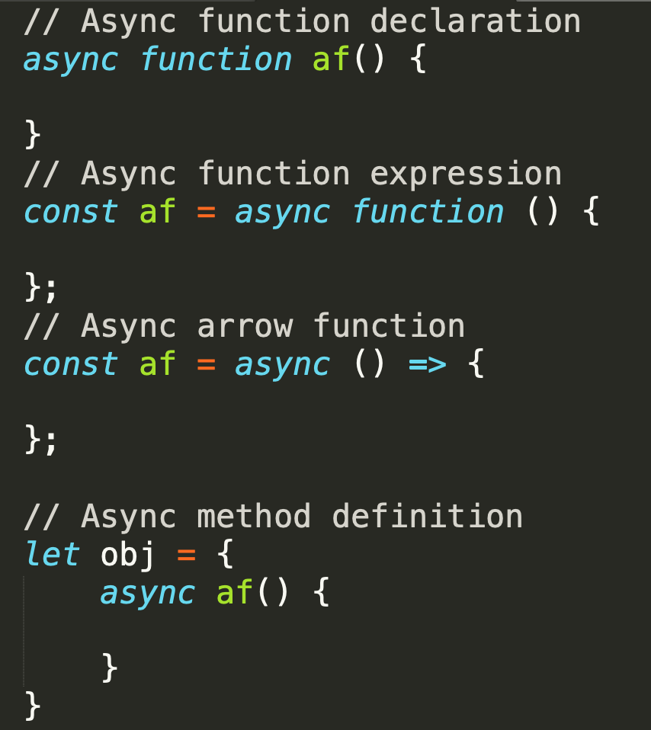
What are ES AsyncFunctions
The async function declaration defines an asynchronous function, which returns an AsyncFunction object.
An asynchronous function is a function which operates asynchronously via the event loop, using an implicit Promise to return its result.
But the syntax and structure of your code using async functions is much more like using standard synchronous functions.
Async/await are built on the concept of promises so you must understand promises well

Slide 44
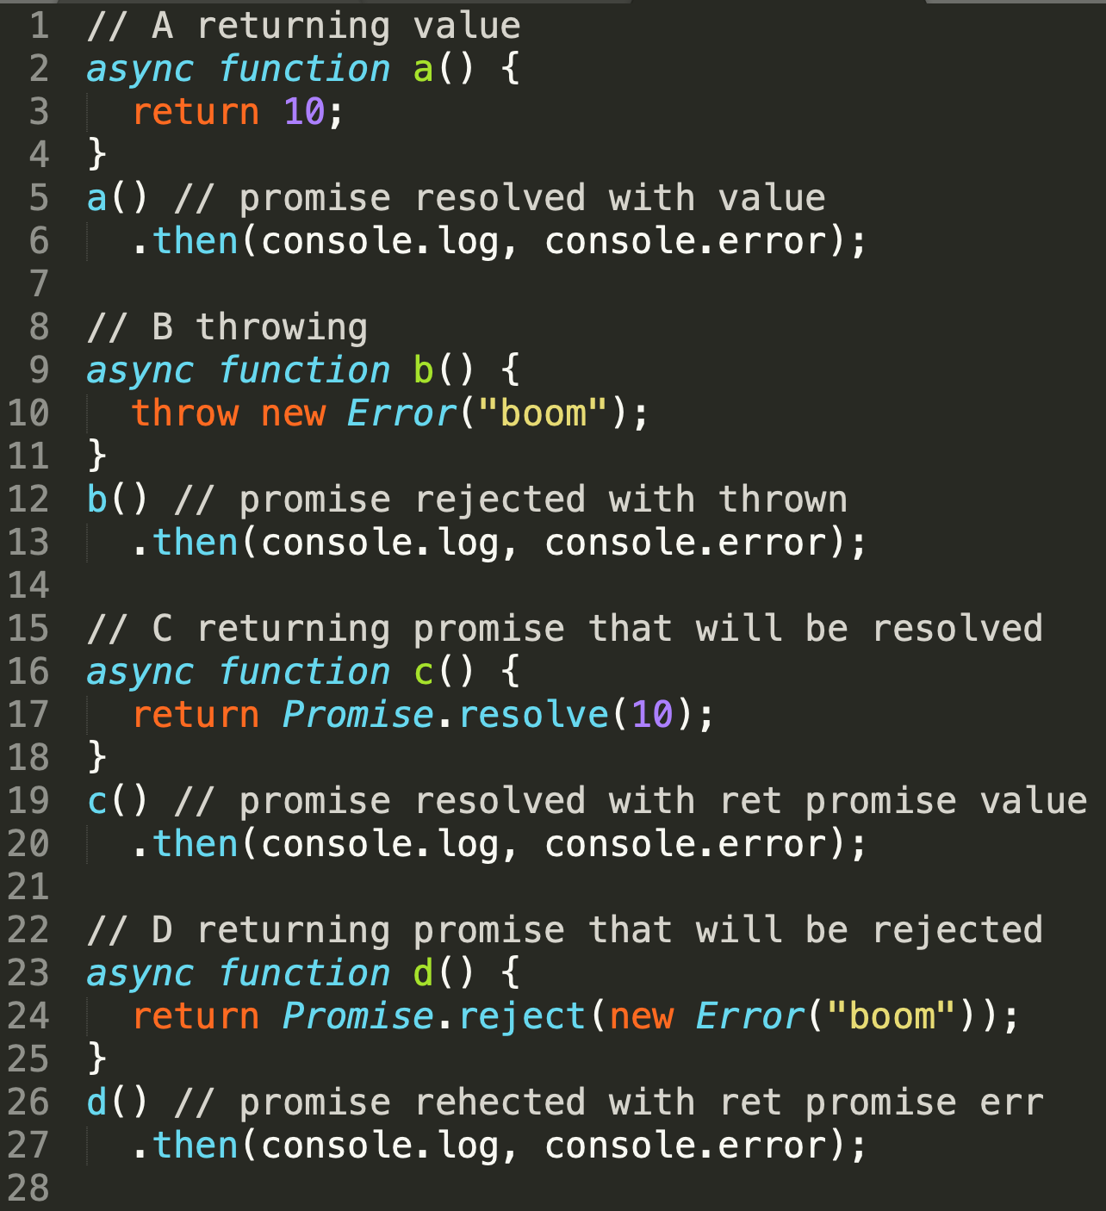
always returns promise
af() call - returns a Promise which will be resolved with the value returned by the async function, or rejected with an uncaught exception thrown from within the async function.
Returning a non-Promise value fulfills p with that value. [a,b]
Returning a Promise means that p now mirrors the state of that Promise. [c,d]

Slide 45

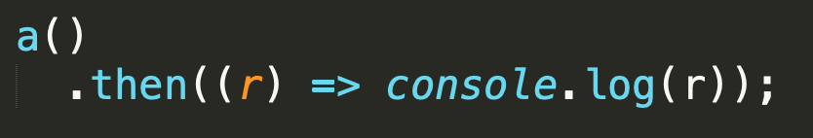
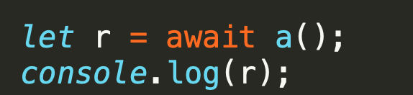
await
Načo nám je AsyncFunction keď aj tak vracia promise ?
syntax and structure of your code using async functions is much more like using standard synchronous functions
Aby sme miesto tohto, mohli písať toto:

Slide 46
await
The await operator is used to wait for a Promise.
The await expression causes
async function execution to pause until a Promise is settled, (fulfilled or rejected),
and to resume execution of the async function after fulfillment.
When resumed, the value of the await expression is that of the fulfilled Promise.
If the Promise is rejected, the await expression throws the rejected value.
It can only be used inside an async function.
Paused and resumed vs. run-to-completion

Slide 47
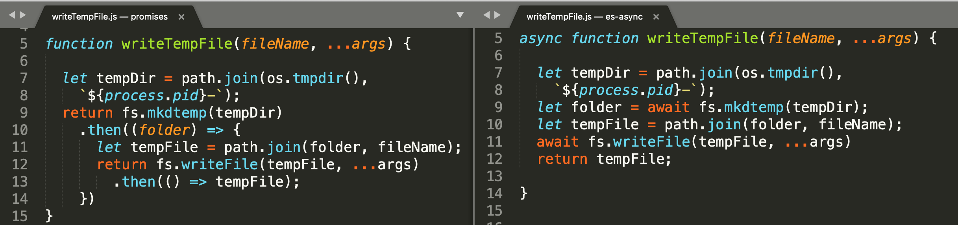
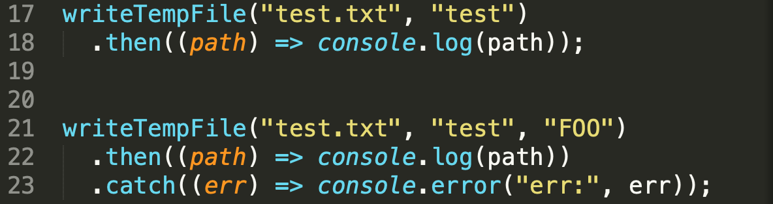
Using async await (writeTempFile sample)
Sequential code
Call of async function has own syntax (await a())
Return plain value, implicit promises
Client code can be the same, async function can be used as any normal function returning promise

Slide 48
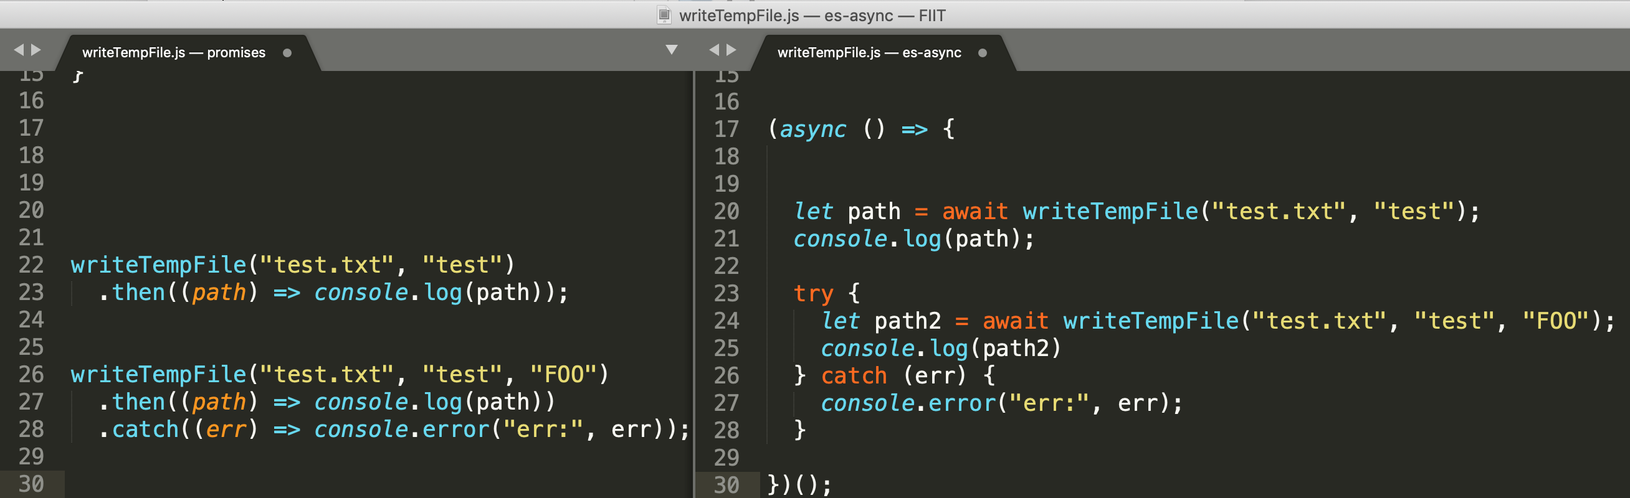
Await can be used only in async functions and basic error handling
Errors from await are thrown so you can use try catch
Writing async code in global block is problematic, must enclose in async function

Slide 49
Async functions – details and inner working
http://exploringjs.com/es2016-es2017/ch_async-functions.html
https://github.com/getify/You-Dont-Know-JS/blob/master/async%20%26%20performance/ch4.md

Slide 50
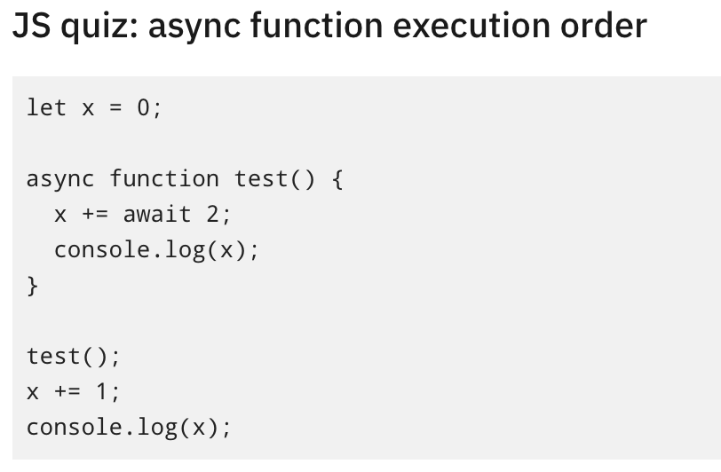
Mixing sync and async code
https://www.youtube.com/watch?v=bfxglBVSNDI

Slide 51
new asyc vs. Promises – subjektívne úvahy na zaver
async await štýl sa vracia „nazad“ od funkcionálneho štýlu k imperatívnemu, štruktúrovanému programovaniu
Čitateľnosť sa zvyšuje nie na úrovni promise vs. await, ale hlavne na úrovni funkcionálne vs. štrukturované programovanie
Inak povedané ak ste vedeli čítať a písať z použitím FP konštrukcií , stačili vám promises
Ak ste to nedokázali a všetko píšete “cez premenne a cykly“ tak potrebujete nutne async/await a async iterators
......
Is this JavaScript for „more dummies“ ?

